Slide 1


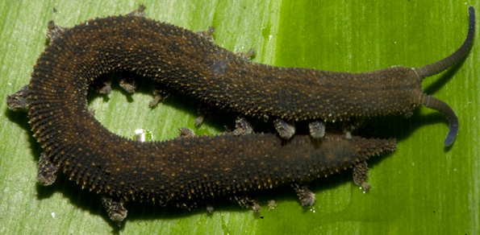
BASRAH UNIVERSITY
Faculty of Education for Pure Sciences
Biology Department
2025- 2026
Phylum :Onychophora
Presented By: Prof. Dr. Sabeeh H. AL-Mayah

Slide 2
phylum Onychophora ( Peripatus )
It is common for members of the phylum onychophoran to be called velvet worms or walking worms.
All modern Onychophorans are terrestrial but fossils, which date back to the Cambrian, are mainly from marine sediments.
Onychophorans look a bit like slugs with legs and when first described in 1825 were thought to be mollusks.
However, now generally considered to be a subphylum of the Arthropoda and placed at the base of the Arthropod family tree.
Triploblastic, bilaterally symmetrical .
Thin cuticle composed of α – chitin .
Body has anterior head & posterior trunk .
Tagmosis : grouping of body segments into similar regions, similar functions, and similar appendages .
Head has 3 pairs of appendages .

Slide 3
Body cavity has blood (open type) .
Heart lies in pericardial sinus .
Respiration through air filled tracheae .
Excretion through paired nephridia .
Nervous system has dorsal brain and ventral nerve cords .
Sensilla and eyes are sensory .
Body wall has many papillae .
Sexes separate and sexually dimorphic .
Viviparous .
Considered as living fossil because the living members appear similar to fossil species as much as 570 million years old

Slide 4
phylum Onychophora
About 10 genera and approximately 110 species. 1.4-15cm in length.
Geographically widely distributed in suitable moist, humid habitats such as tropical (e.g. Congo, northern South America, Himalayas) and southern temperate forest (e.g. New Zealand, Australia, South Africa, Andes).
Limited habitat distribution (and exclusively nocturnal behavior) related to problem of water loss.
Like other arthropods, Onychophorans have a chitinous cuticle, which is molted as they grow, but it is thin and flexible, non-waxy and permeable.

Slide 5
phylum Onychophora
Onychophorans do not have jointed legs but possess other arthropod characteristics including a reduced coelom and a hemocoel.
The 14-43 pairs of legs are large and conical with terminal pads and claws.
They move using their legs and by extending and contracting the body.
Most are predators and use glue which they can spray from a pair of oral papillae to catch their prey.
They can spray two streams of glue up to 50cm and this hardens almost immediately trapping the prey in a net of sticky threads.
ZA z

Slide 6
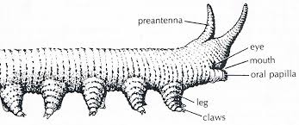
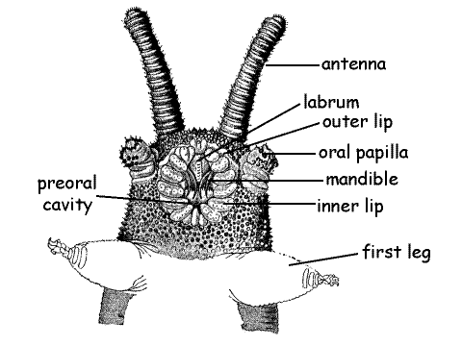

Slide 7
Adhesive glands
Thought initially evolved for use in defense
Hunting adhesive only known in this phylum and some arachnids
Attack prey by shooting glue from a distance through oral papillae, then onychophoran can bite through protective coverings and liquify victim’s tissues

Slide 8
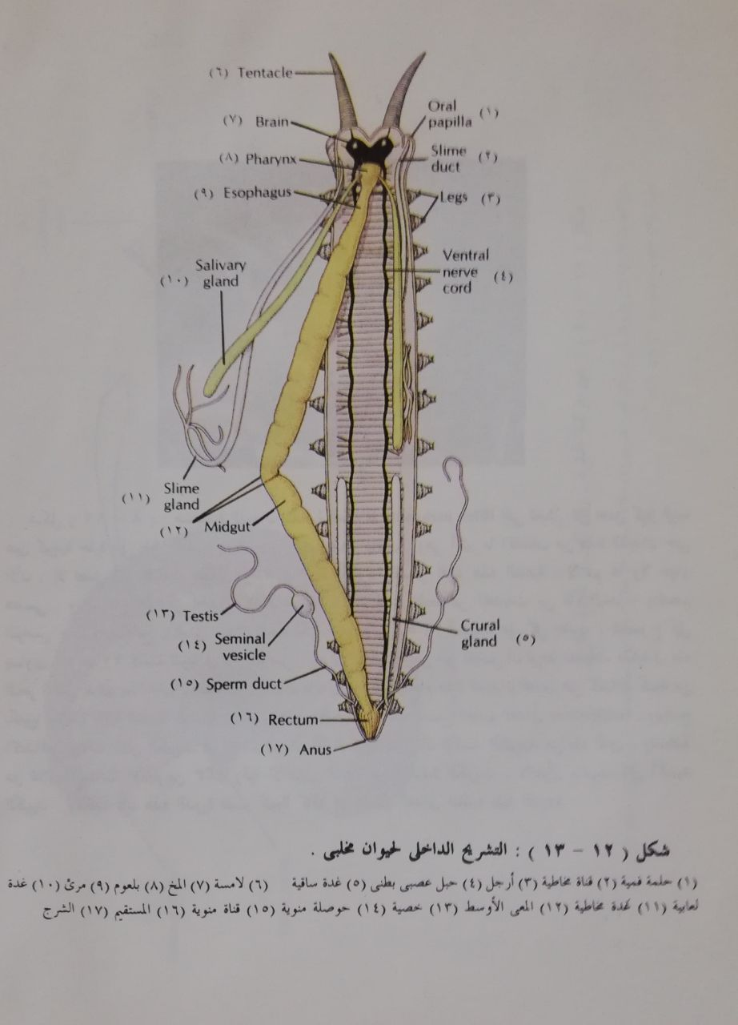

Slide 9
Respiratory system
There is a bronchial apparatus for respiration that branches to all parts of the body and is connected to the outside by openings or spiracles that spread throughout the body and spiracles cannot be closed to prevent water loss. Therefore, the presence of these animals is limited to humid environments and lives hidden among the leaves and their activity is nocturnal .

Slide 10
Reproduction system
The onychophoran are dioecious and have double genitals and the males lay their sperm bundles on the back of the female ,who may collect several of them, and the white blood cells dissolve the skin under the sperm bundles, so the sperm can enter the body cavity and migrate in the blood to the ovaries to fertilize the eggs.
Onychophora may be oviparous or ovoviviparous or viviparous.

Slide 11
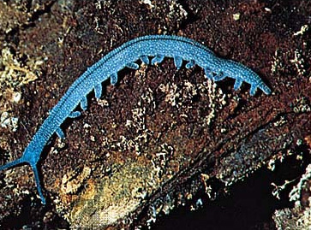
Similarities between Annelids and Arthropods
Arthropods are metameric and their segments have appendages
Nervous system with ventral nerve cords
Phylum Onychophora
Annelid-like
Segmented; unjointed appendages; similarity in structure of the body wall; segmentally arranged nephridia; pigment-cup ocelli
Arthropod-like
Reduced coelom, open circulatory system, tracheal system; soft cuticle composed of chitin
Peripatus, a small, nocturnal form found among the leaf-litter of tropical forests of South America.

Slide 12
What are they?
Annelid: Excretory system; no joined appendages; hydrostatic skeleton
Arthropod: Respiratory system; embryology; chitin-containing cuticle
Onychophorans: Diffuse nervous system; adhesive glands; legs are soft, plump and not jointed, and ‘walk’

Slide 13
Comment on the phylogenetic status of Peripatus./Discuss on the systematic position of Peripatus.
Peripatus have both annelidan & arthropodan characteristics. Therefore, they are regarded to be intermediate stage or connecting link between Annelida & Arthropoda.
However, they appear to be more closely allied to arthropods than to annelids. They may represent an offshoot from near the base of the arthropod line. Based on such phylogenetic considerations, Manton & other contemporary zoologists have included onychophorans (Peripatus) within the Arthropoda as a subphylum or class.
But absence of exoskeleton, & jointed limbs & the presence of primary annelid characters in Onychophora create serious problems.
In fact, onychophorans are neither annelids nor arthropods but possess distinct characteristics of their own. Hence now a days, Onychophora is considered as a separate phylum.
The modern view holds that Onychophora is not an evolutionary link between Annelida & Arthropoda but a distinct surviving branch. This is supported by the discovery of a mid-Cambrian fossil, Aysheaia which closely resembles the modern Onychophora.

